Slide 1
Social Network Analysis in Health Services Research: Theory, Methods, and Examples
Jane Banaszak-Holl, University of Michigan
Tom Rundall, University of California, Berkeley
Doug Wholey, University of Minnesota
AcademyHealth 2004

Slide 2
Presentation Organization
Presentations
  Jane Banaszak-Holl – Social Networks as a Conceptual Framework for Health Services Research
  Tom Rundall - Using A Social Networks Approach
  Doug Wholey - Using Social Networks To Study Medical Clinics
Questions following each presenter and at end of presentation
40 copies of slides available at entrance, 15 CDs with UCINET VI and sample network data with presenters

Slide 3

Social Networks as a Conceptual Framework for Health Services Research
Jane Banaszak-Holl
University of Michigan
Academy Health, June 2004

Slide 4
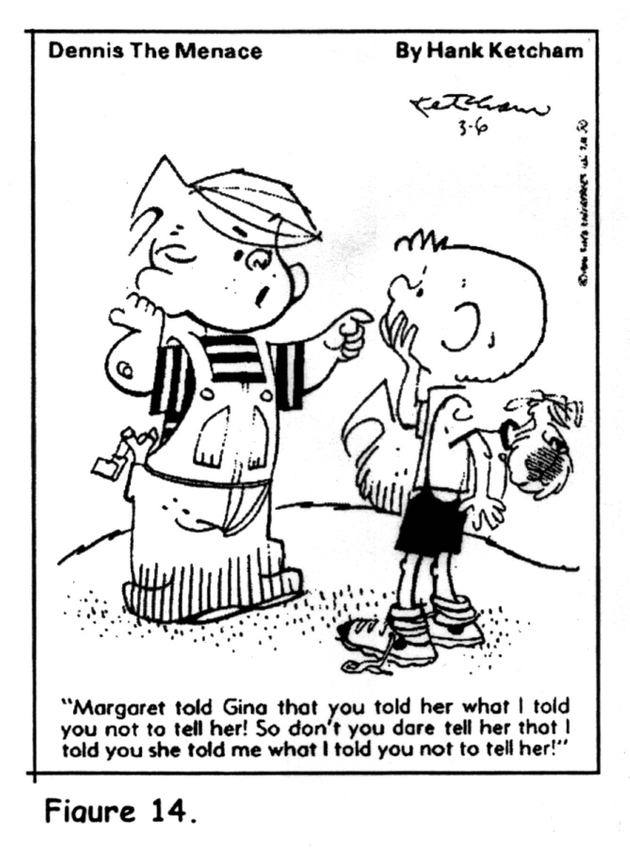
Who ya know…..

Slide 5
Who ya know…..affects
Access to information
  How get current state-of-the art info
    Adoption of tetracycline (mid-1950s)
Opportunities for action
  Coordination of multiple experts/professionals
    Minimally invasive cardiac surgery (current)
Individual’s behavior, health and welfare
  not discussed today but extensive work here

Slide 6
But first, what is a social network?
A set of relationships (ties) with stable patterns of repeated interactions
Unit of analysis is relationship
  There are multiple types of relationships
      E.g., work with, provide informal advice, refer patients, discuss care management…..
  Possible to have multiple relationships with someone
  But, relationships do not necessarily transfer across activities

Slide 7
Access to information¹
People turn to others for cues
  What to do with new technologies
Who do you turn to?
  Leaders in the field
  Among those with whom we have a social relationship
    Competitors (those in similar situation to ourselves) and our friends
    Competitive relationship more likely to lead to adoption than friendship
1 Burt, R.S. (1987). Social contagion and innovation: Cohesion versus structural equivalence. American Journal of Sociology 92:1287-1335.

Slide 8
Opportunities for action---
Minimally invasive cardiac surgery²
Relationships help us make sense of the world around us.
2. Edmondson, E.C. 2003. Framing for learning: Lessons in successful technology implementation. California Management Review 45(2):34-54.

Slide 9
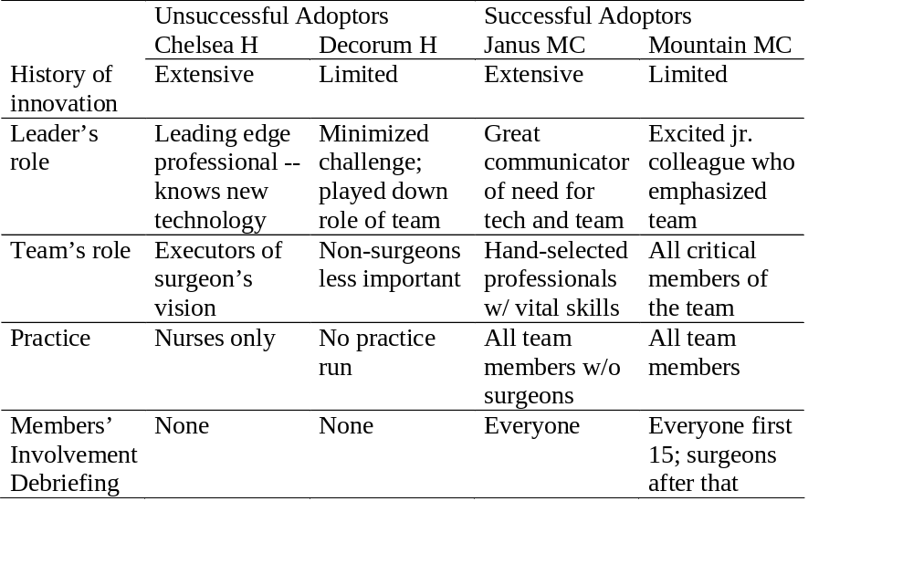
Opportunities for action---
Minimally invasive cardiac surgery²
2. Edmondson, E.C. 2003. Framing for learning: Lessons in successful technology implementation. California Management Review 45(2):34-54.

Slide 10
The nature of relationships important!
A friend of a friend is a friend (strong ties)
  Common acquaintances come with familiarity
  Friendship ties are very strong and cross several types of relationships
When you refer to a clinician who refers to another clinician, do you refer to the latter as well? (weak ties)
  Weak ties often link you to the less familiar
  We gain access to more unique information through unique ties

Slide 11
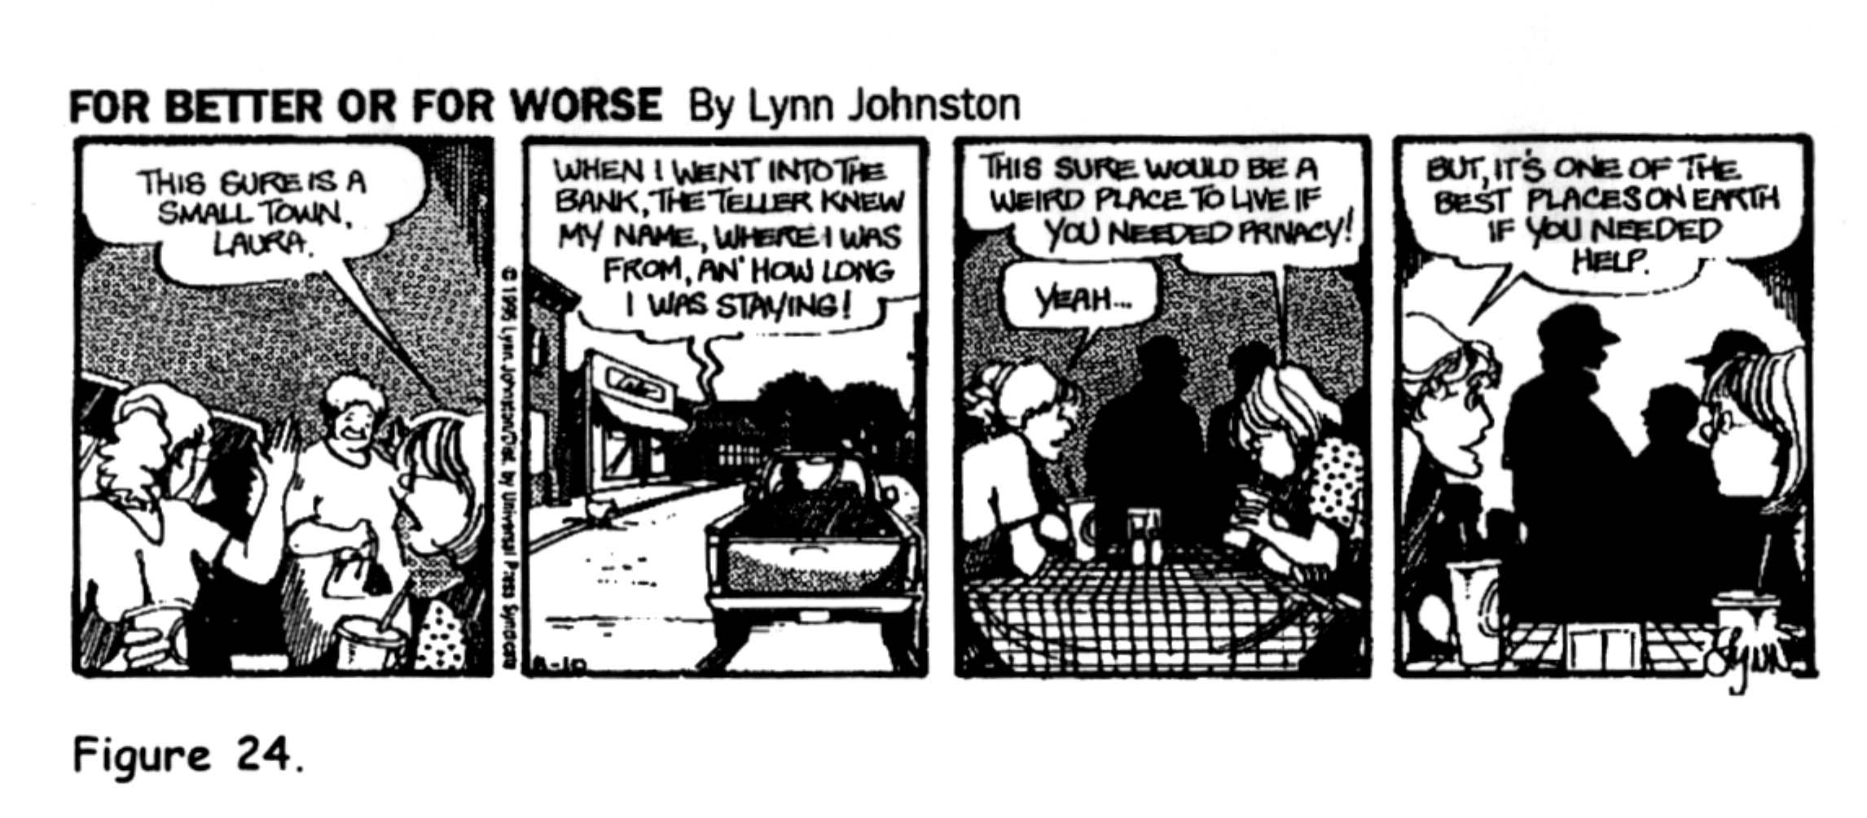
Types of Relationships
What is the nature of the relationship?
This sure is a
small town
Laura
When I went into the bank, the teller knew my name, where I was from, an’ how long I was staying!
This sure would be a weird place to live if you needed privacy!
But, it’s one of the best places on earth if you needed help.
Yeah--

Slide 12
Administrative vs. clinical ties
Coordination of specific patient cases does not lead a group to engage in general coordination of multiple cases or more general strategic planning for administration
Springfield Agencies Serving the Disabled
Information Sharing
Planning
(on avg. ties to 17/68)
(on avg. ties to 7/68)
2 ADC
3 GO
3 HHA
2 IR
3 MHS
4 PT
1 ADC 3 ES
4 GO
5 IR
2 MHS
1 PT
1 T
1 ADC
2 ES
1 GO
1 HMO
1 H
1 IR
3 MHS
2 SC
1 ADC
3 IR
1 MHS
3 PT
5 SC
1 T
5
4
7
6
3
2 ADR
4 MHS
1
3
1 ADC
3 GO
1 HC
2 HMO
3 HHA
2 IR
3 PT
3 SC
3 T
1
2 ADR
1 HC
2 IR
1 MHS
4
1 ADC
1 H
6 HHA
1 HMO
2 T
2 GO
2 H
2 HHA
2
1 ADR
1 ES
2 GO
1 HC
3 HHA
2 H
3 IR
2
1 ADR
1 GO
2 HC
2 IR
5
1 ADC
1 GO
1 HC
1 HHA
2 HMO
3 PT

Slide 13
Identifying network data
Population boundaries important
  Multiple types with common purpose
    E.g., all physicians, nurses, technicians, staff in a clinic
  All actors of one type
    E.g., referrals among all physicians
Identify ties
  For full population
  Specify type of activity (links) for network
  Dichotomous or valued
    present or not vs. none, a little, some, a lot
  Determine whether directional or not
    work with and friends with vs. provide information to

Slide 14
Types of Agencies Serving Disabled in Springfield Area
Benefits and Financial Services
10 - Employment Services
9 - Government Offices
Health Related Chronic Care
9 - Alcohol & Drug Rehab
12 - Home Health Services
14 - Mental Health Services
20 - PT, OT, & Speech Therapy
3 - Respite Services
Medical Care Providers
6 - HMOs
8 - Hospitals & Health Ctrs
Social Service Agencies
4 - Adult Day Care
4 - Emerg. Response & Transportation
15 - Information & Referral
10 - Senior Centers
3 - Support Groups

Slide 15
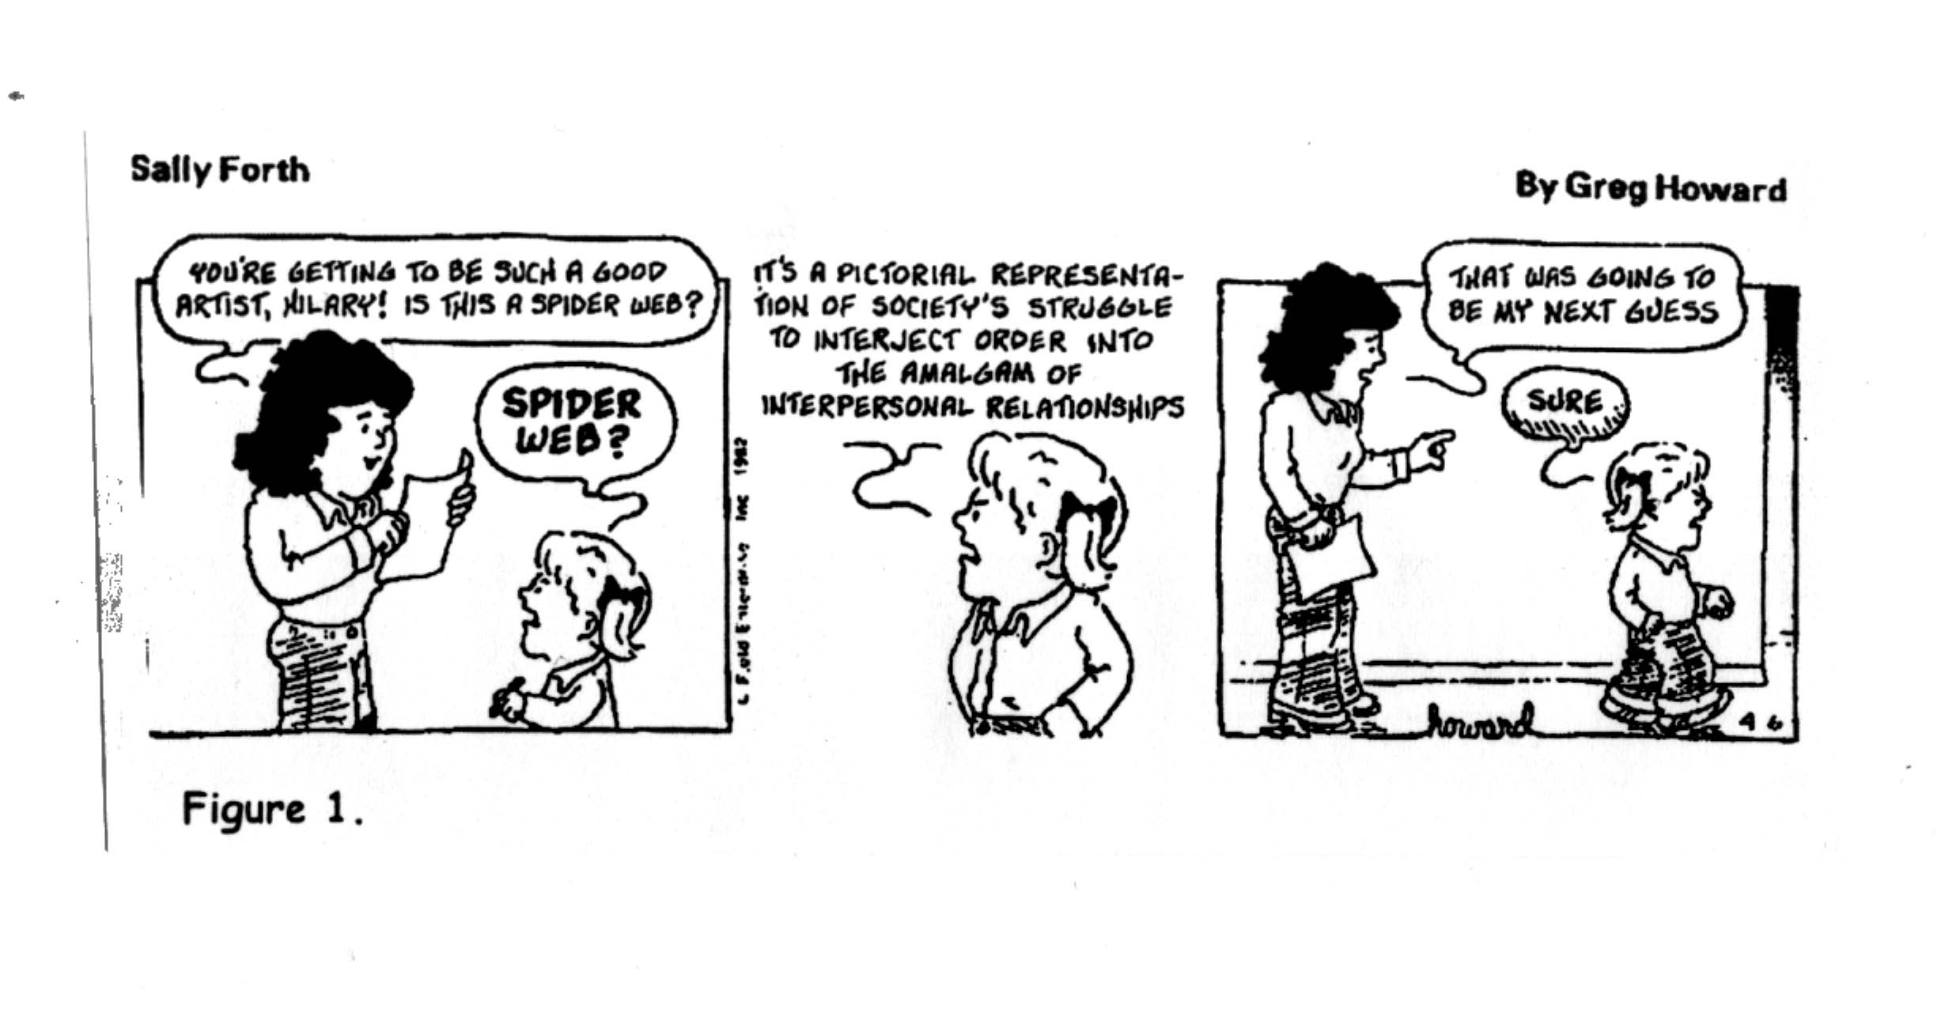
Analysis of social networks

Slide 16
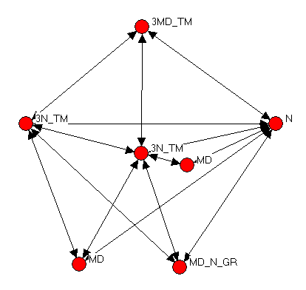
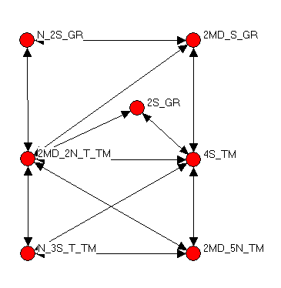
Examples from clinical professionals in outpatient setting (Wholey et al)
Clinic A---work with
Clinic B---work with

Slide 17
Looking within the picture---
1
Compare 1 & 3
  They are not connected directly but share similar traits:
  Share partners (2,5,7)
  Same number of ties
  Share an indirect relationship which can still lead to information sharing
2
7
5
6
3
4

Slide 18
Building blocks of networks---Systematic analysis of patterns
1
 | 1 | 2 | 3 | 4 | 5 | 6 | 7
1 | -- | 1 | 0 | 0 | 1 | 0 | 1
2 | 1 | -- | 1 | 1 | 1 | 0 | 1
3 | 0 | 1 | -- | 0 | 1 | 0 | 1
4 | 0 | 1 | 0 | -- | 1 | 0 | 1
5 | 1 | 1 | 1 | 1 | -- | 1 | 1
6 | 0 | 0 | 0 | 0 | 1 | -- | 1
7 | 1 | 1 | 1 | 1 | 1 | 1 | --
 | 1 | 2 | 3 | 4 | 5 | 6 | 7
1 | -- | 1 | 0 | 0 | 1 | 0 | 1
2
3 | 0 | 1 | -- | 0 | 1 | 0 | 1
4
5
6
7
2
7
5
6
3
4

Slide 19
More on Matrix Representation:
1. Commonly ignore diagonal---what does relationship to self mean?
 | 1 | 2 | 3 | 4 | 5 | 6 | 7
1 | -- | 1 | 0 | 0 | 1 | 0 | 1
2 | 1 | -- | 1 | 1 | 1 | 0 | 1
3 | 0 | 1 | -- | 0 | 1 | 0 | 1
4 | 0 | 1 | 0 | -- | 1 | 0 | 1
5 | 1 | 1 | 1 | 1 | -- | 1 | 1
6 | 0 | 0 | 0 | 0 | 1 | -- | 1
7 | 1 | 1 | 1 | 1 | 1 | 1 | --
Size of matrix becomes large fast
N*(N-1)
2. Identify groups of actors with common patterns defines a structurally equivalent set.
3. Networks vary in the total number of ties between actors (count 1’s in matrix)

Slide 20
Centrality in networks
Centrality can be defined as the number of ties you have or rather the number of people whom you are between
On the other hand, centrality is better defined by the centrality of those to whom you are connected (ie, the number of partners your partner has)

Slide 21
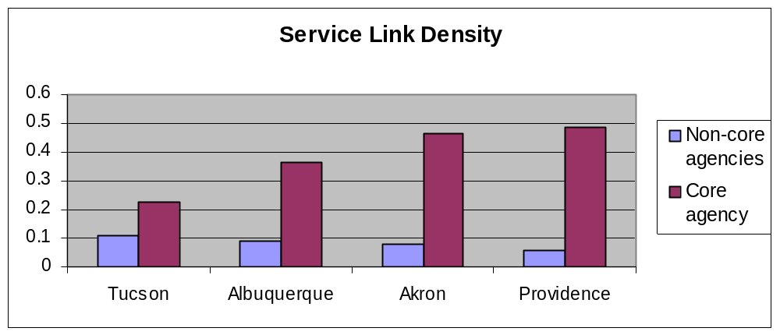
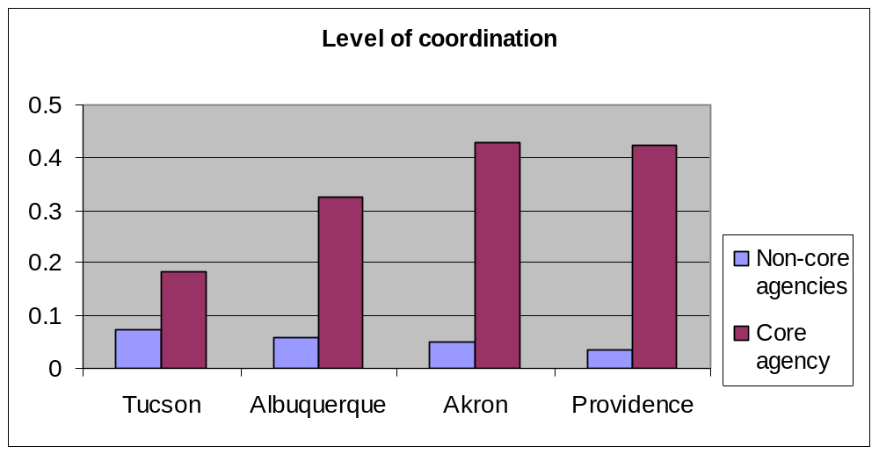
Four agency communities serving the mentally ill¹
Each city had between 30-35 agencies serving the mentally ill.
1. Provan, K.G. and Milward, H.B. (1994). Integration of community based services for the mentally ill and the structure of public funding: A comparison of four systems. Journal of Health Politics, Policy and Law 19(4):865-894.

Slide 22
Conclusions from Provan & Milward
When state fiduciary control was weak
  Core agency was weaker
  Non-core agencies (includ service providers) coordinated services on their own.
  States spent less on coordination costs
Direct state control encouraged greater centralization.
  Centralized networks served clients efficiently

Slide 23
Methods for analyzing networks
Matrix methods
  UCINET (www.analytictech.com/ucinet.htm)
Graphic methods
  Krackplot (www.andrew.cmu.edu/user/krack/krackplot/krackindex.html)

Slide 24
Using A Social Networks Approach
Tom Rundall
University of California, Berkeley
Academy Health, June 2004

Slide 25
Types of Questions Addressed in Health Services Research
Social network theory and methods may be applied at any level of analysis
  Individual
  Group
  Organizational sub-unit
  Organization
  Community
  Organizational field

Slide 26
Types of Questions Addressed in Health Services Research
Organizational researchers use organizational network variables as
  Dependent variables
  Independent variables
  Structural descriptors

Slide 27
Types of Questions Addressed in Health Services Research
Organizational network variables as dependent variables
Organizational Characteristics Location in Network
Status Centrality (e.g. for referrals received)
Scope of services Degrees
Number of clients served Betweenness
Ownership/control Structural Equivalence
Homophily Boundary Spanner

Slide 28
Types of Questions Addressed in Health Services Research
Organizational network variables as independent variables
Location in Network Organizational Outcome
Centrality Community influence
Degrees Adoption of innovations
Betweenness R&D collaborations
Structural Equivalence Coordination of patient care
Boundary Spanner Intensity of care

Slide 29
Types of Questions Addressed in Health Services Research
Network variables as structural descriptors
  Network Centralization
    A very centralized network is dominated by one or a few very central nodes.
    If these nodes are removed or damaged, the network fragments into unconnected sub-networks
    A highly central node can become a single point of failure. A network centralized around a well connected hub can fail abruptly if that hub is disabled or removed.

Slide 30
Types of Questions Addressed in Health Services Research
Network structure as descriptors
  Cluster analysis
    Find cliques and other densely connected clusters
  Structural equivalence
    Determine which organizations play similar roles in the network
  Structural holes
    Find areas of no connection between organizations that could be used for advantage or opportunity
  Small worlds
    Find clusters of organizations with short path lengths, common in networks exhibiting highly efficient small-world behavior

Slide 31
Exemplars of Organizational Network Research
Organizational network variables as dependent variables
Patterns of Referral Among Internists in Private Practice: A Social Exchange Model, Stephen M. Shortell, Journal of Health and Social Behavior Vol 14 (December 1973), 335-348
What provider characteristics account for the social network based upon “who refers to whom” among internists in a suburban community?
“High status internists tended to refer primarily to other high status physicians while lower status interns referred more often to higher status physicians than to lower status physicians. The net effect was that referrals generally tended to flow from physicians of lower status to those of higher status” p. 346.

Slide 32
Exemplars of Organizational Network Research
Organizational network variables as dependent variables
Technology and Interorganizational Activity as Predictors of Client Referrals
Keith G. Provan, The Academy of Management Journal, Vol 27, No. 4 (December 1984), 811-829.
What characteristics of human service agencies best predict referrals from and referrals to other organizations?
“One conclusion is that the flow of clients to an agency through referrals seems to be a function of internal organization factors relating to the processing of clients served. Specifically, a high level of referral inflows is likely for reactive agencies and those providing intensive services to their clients” p. 828.

Slide 33
Exemplars of Organizational Network Research
Organizational network variables as dependent variables
Effects of Generalism and Niche Overlap on Network Linkages Among Youth Service Agencies, Douglas R. Wholey & John W. Huonker, Academy of Management Journal, Vol. 36. No. 2 (1993), 349-371.
    Is generalism positively associated with linkages between social services agencies, as homophily theory suggests, or negatively associated with such linkages, as exchange theory suggests?
    Are generalist social service agencies more likely to link with generalists, as homophily theory suggests, or more likely to link with specialists, as exchange theory suggests?
    Is niche overlap importance positively associated with linkages between social service agencies, as homophily theory suggests, or is it negatively associated with linkages, as exchange theory suggests?
“The general predominance of homophily, rather than exchange, as a determinant of interorganizational networks is consistent with the interpretation that organizations in a network cooperate to deliver services to some population … or work together to develop resources for the network as a whole …” p. 366-367.

Slide 34
Exemplars of Organizational Network Research
Organizational network variables as dependent variables
Organizational Characteristics Associated with Agency Position
in Community Care Networks, Jane Banaszak-Holl, Susan Allen, Vincent Mor, and Thomas Schott, Journal of Health and Social Behavior Vol. 39 (December 1998), 368-385.
This study examined how organizational characteristics (e.g. ownership/control, type of service, operating budget) affected agency participation and centrality in community service networks. The authors use network analytic techniques to measure the centrality of each agency and to identify agencies occupying the same structurally equivalent position within a community care network serving people with disabilities.
“Our results call into question whether privatization is conducive to building community-delivery systems” p. 368-385.

Slide 35
Exemplars of Organizational Network Research
Organizational network variables as independent variables
The Diffusion of an Innovation Among Physicians, James Coleman, Elihu Katz, Herbert Menzel, Sociometry, Vol. 20, No. 4 (Dec.,1957), 253-270
This study analyzed the diffusion of a new drug among doctors in relevant specialties in four cities. In particular, the study assessed the effects of social networks of interpersonal relationships at each stage of the diffusion process.
1. The date on which a doctor first prescribed the new drug was related to a large number of his individual attributes, e.g. his age, the number of medical journals he subscribed to, his attachments to medical institutions outside his community, and certain attitudinal characteristics.
2. But, even stronger relations were found between date of doctor’s first prescription and their social network relationships. Doctors who were mentioned by many of their colleagues in answer to any of the three sociometric questions used the drug, on the average, earlier than those who were named by few or none of their colleagues.
“More generally speaking, the degree of a doctor’s integration among his local colleagues was strongly and positively related to the date of his first use of a new drug” pp. 256-257.

Slide 36
Exemplars of Organizational Network Research
Organizational network variables as independent variables
The Structure of Community Organization Networks, Joseph Galaskiewicz,
Social Forces, Vol 57, No. 4 (June 1979), 1346-1364
This study describes the money, information, and supports flows (exchanges) among a wide range of formal community organizations. The effects of these exchanges on the centrality of organizations, and the effect of centrality on organizations’ influence in the community are assessed.
1. The structures of the organizational networks for money, information, and support were quite different from one another.
2. The amount of money organizations controlled was the strongest predictor of organizations’ centrality.
3. Centrality in all three networks had a strong positive direct effect on organizations’ influence.
4. Control over money had only an indirect effect (through centrality) on community influence.

Slide 37
Exemplars of Organizational Network Research
Organizational network variables as independent variables
Interorganizational Collaboration and the Locus of Innovation: Networks of Learning in Biotechnology, Walter W. Powell, Kenneth W. Koput, & Laurel Smith-Doerr, Administrative Science Quarterly, Vol.41, No. 1 (March 1996), 116-145.
Example hypothesis: The greater a firm’s centrality in a network of relationships at a given time, the greater its number of subsequent R&D collaborations, controlling for prior collaborative activity.
All hypotheses were supported. The authors comment:
“In contrast to the much discussed liability of newness hypothesis … there appears to be a liability of unconnectedness at work in biotechnology, and other fields in which intellectual developments are expanding rapidly. Rather than using external relations as a temporary mechanism to compensate for capabilities a firm has not yet mastered, firms use collaborations to expand all their competencies” p. 143.

Slide 38
Using Social Networks To Study Medical Clinics
Doug Wholey
University of Minnesota
Academy Health, June 2004
Acknowledgements: This works is done in collaboration with Amy Wilson, Bill Riley, David Knoke, and Leif Solberg with the assistance of Ward Godsall & David Yauch, Aspen Medical Group.

Slide 39
Organization
Overview
Description of study setting – 3 clinics
Description of overall results
Analysis of
  Work with relationship
  Discuss care management processes relationship
  Informal consulting relationship

Slide 40
Health Care as a System – Crossing the Chasm
[A health care system is] a set of connected or interdependent parts or agents – including caregivers and patients – bound by a common purpose and acting on their knowledge. … Health care systems are … composed of individuals – patients and clinicians who have the capacity to learn and change as a result of experience
  Institute of Medicine Report Crossing the Quality Chasm, p. 68
Notes:
Comment about Herbert Simon, Stuart Kauffman -

Slide 41
Teams and Systems
Teams are the building blocks of systems
  Small groups of interdependent people working together on a shared task
  Teams are linked together in a larger system (macro-system)

Slide 42
Why Do We Care About Teams?
Changing health care environment will result in increased division of labor and use of teams
  Proliferation of technicians or professional differentiation
  Aging population and increasing prevalence of patients with chronic conditions with co-morbidities
Organizational research shows that teams and relationships can be managed to improve performance

Slide 43
Studying and Managing Teams
Effective team management teams requires research results about teams
Cumulative results requires
  A clear definition of a team and its characteristics
  Methods for reliably identifying teams
  Methods for measuring teams

Slide 44
Teams and Boundaries: Examples from Organizational Research
Much research on teams identifies teams with relatively clear boundaries
  Airline crews
  Surgical teams
  IHI QI teams
Problem: In clinical or health care settings, teams are often not clearly identified
Social network theory and methods can be used to identify and measure teams

Slide 45
Teams: An Integrative Definition
Teams have a defined boundary, consist of at least two members who work interdependently on a common task and who share responsibility for the task.
  Captures the idea of a small group of people working together with a common fate who can monitor each other and who are jointly accountable.
Care teams
  Consist of diverse occupations and have the task of caring for a patient population

Slide 46
Types of Teams
 |  | Division of Labor
 |  | Low | High
Duration | Low | Airline crew Care Team | Ophthalmological Surgery Team
 | High | Rowing crew PPT | Transplant teams
Duration – length of time team is together
Division of labor – variety of occupations on team

Slide 47
Management Implications of Duration and Specialization: Temporary Teams
Assign physicians and nurses to work together from occupational pools on a regular interval (e.g., weekly, daily)
  Strengths
    Transfer of ideas among similar professionals
    Specialization
    Staffing
  Weaknesses
    Cross-functional innovations inhibited
    “Siloing” by occupation
  Problem: Different “individual styles”
    Standardization required

Slide 48
Management Implications of Duration and Specialization: Care Teams
Assign specific physicians and nurses to work together regularly
  Strengths
    Each team has specific understandings among members, tendency to become isolated
    Cross-functional, task focused innovation
  Weaknesses
    Loss of specialization
    Staffing adjustments if someone is ill or leaves
  Problem: Team becomes isolated from others
    Link team with other teams using informal consulting and other relations

Slide 49
Social Networks Within Clinics: Study Setting – 3 Clinics
A - pediatrics service within a larger multi-specialty clinic. It consists of 6 physicians, 1 nurse practitioner, 6 medical assistants, 2 registered nurses and 2 receptionists with over 15,000 patient visits annually.
B - suburban primary care clinic with 10 providers of whom 8 are primary care(5 adult physicians, 1 pediatrician, 1 OB/GYN and 1 O.D) with 2 RNs, 2 LPN’s, 4 medical assistants, 4 medical records personnel, and 4 receptionists.
C - urban/suburban primary care clinic with 12 providers of whom 11 are primary care specialties (7 internal medicine, 1 pediatrics, 1 OB/GYN, 1 nurse practitioner, 1 counselor).with 2 RNs, 4 LPNs, 3 medical assistants, 6 receptionists, and 4 medical records personnel.

Slide 50
Relations Studied
Work with
  “work with to provide patient care”
informal consulting
  “provide information to in informal consults”
  “receive information from in informal consults”
Discussing care management processes
  “talk with about managing your clinic”
Patient referral (work flows)
  “refer patients to”

Slide 51
Methods
Graphical analysis
Multivariate analyses to test hypotheses

Slide 52
General Results for All Clinics
Work with relation most dense – discuss care management organization least dense
Nurses play a central role – manage patient flows and work processes
  Patient referral process is centralized – a few key actors receive patients and refer them to a variety of others
  In work with relationship, nurses occupy more central positions - physicians less central
    Status and centralization?

Slide 53
Who Works With Whom: Hypotheses
Determinants of a relationship
  Patient referral flows increase having a work with relationship
Foundation for groups in clinics
  Temporary teams
    Evidence: individuals from same occupation are grouped together
  Care teams
    Evidence: individuals from different occupations are grouped together

Slide 54
Identifying Work Groups Based on Work With Relationship
Identified work groups using social network grouping algorithms based on structural equivalence
  Group individuals who report similar relationships to others
  Group individuals who report working together

Slide 55
Work Groups Based on Work With Relationships In Clinic A
Notes:
Clinic A is organized by occupational group with groups of different occupations interacting (nurse with physician groups)
This could be due to clinic A being a small pediatrics group

Slide 56
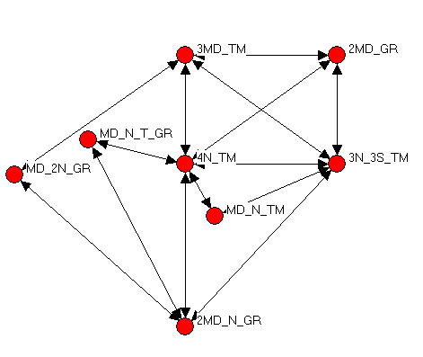
Work Groups Based on Work With Relationships In Clinics B and C
Clinic B
Clinic C
Notes:
Clinic B has a care team organization – groups based on different occupations
Clinic C has a mix of care teams and occupational groups. The occupational groups are linked to each other

Slide 57
Work With and Teams: Summary
Teams affected by patient referral patterns
Team organization reflects either
  Temporary teams
  Care teams

Slide 58
Work With and Teams: Managerial and Research Questions
Do the teams that exist reflect our ideas about the teams the organization believes exist?
  Do staffing rules match team organization?
  Are the actors who we expect to be working together actually working together?
Team type and organizational performance
  If temporary teams are being used, are behaviors standardized (e.g., airline crew model)?
  If care teams are being used, how is uniformity across teams insured?

Slide 59
Discussing Care Management Process Relationships: Hypotheses
Refers to talking about operation of the clinic as a system
Expect care management process discussion to be influenced by
  Work relationships
    Patient referral, work with, being in same work group
  Occupational similarity

Slide 60
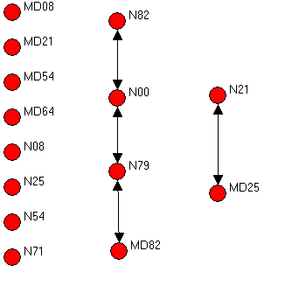
Discuss Care Management Processes and Organization: Clinic A
Actors not connected to other actors are isolates
  Many actors not involved in discussing care management organization
Nurses more likely to be involved
  4 of 8 nurses involved
  2 of 6 physicians involved
Notes:
Clinic A is a small specialty clinic embedded in a multi-specialty clinic, some of management processes and management process discussions may take place with actors outside of clinic.

Slide 61
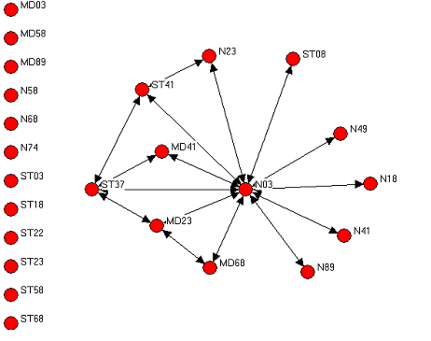
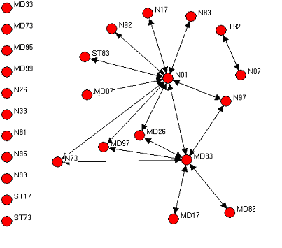
Discuss Care Management Processes and Organization: Clinics B and C
Networks centralized around a nurse
  Benefits – Efficiency
  Risk – If central nurse leaves, performance can be degraded
Notes:
Note centrality of nurses, note number of isolates, note wheel/star shape

Slide 62
Discussing Care Management Processes: Summary
Discussing care management processes relationship is difficult to predict and interpret
Interpretations
  Glass half empty
    Appropriate levels of discussion are not occurring
  Glass half full
    Discussion of care management processes does not occur often – when problems occur they are solved
    So - discussing care management processes relatively infrequent

Slide 63
Discussing Care Management Processes: Managerial and Research Questions
How does centrality of care management process discussion affect
  Stable operations?
    Exit of central individual?
    Should redundant paths be built?
  Safety –
    Does centrality compromise safety (redundancy allows checks)

Slide 64
Informal Consulting Relations: Definitions
“An informal or "curbside" consultation is the process in which a physician seeks information or advice about patient care from another physician who has a particular expertise without obtaining a formal consultation between the patient and the consultant physician at that time.”
  Keating, Zaslavsky, & Ayanian (1998, 901)
"an informal process whereby a physician obtains information or advice from another physician to assist in the management of a particular patient. The consultant neither reviews the patient's record nor examines the patient and does not document his/her recommendations."
  Kuo, Gifford, & Stein (1998, 905-906)

Slide 65
Informal Consulting –
Existing Literature
Describes physician informal consulting behavior – it does not describe the structure of informal consulting
  Does one physician consult with many others (centralized)?
  Do small groups or pairs of physicians consult with each other
Focuses on physicians – it neglects
  Informal consulting within other occupations (nurses)
  Informal consulting between other occupations

Slide 66
Informal Consulting –
Research Goals
Within a clinic
  Describe structure of informal consulting
  Describe informal consulting among different occupations
  Describe informal consulting between occupations

Slide 67
Informal Consulting: Hypotheses
Informal consulting relations are more likely between individuals
  Work relationships
    Who have a patient referral relationship
    Who work with each other
    Who are in the same work group
  Occupation
    Who are the same occupation

Slide 68
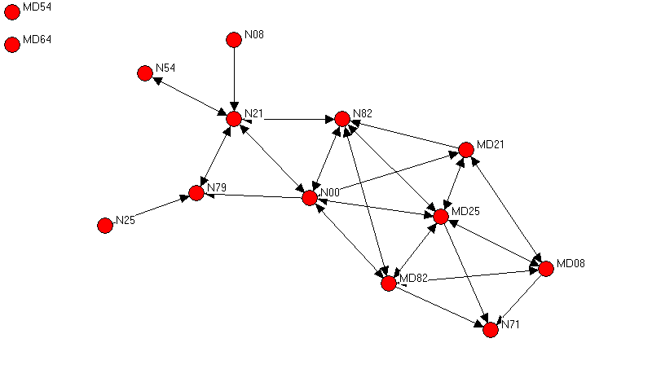
Informal Consulting In Clinic A
Actors not connected to other actors are isolates. informal consulting appears to be occupationally focused, with some bridging in clinic B
Nurses and physicians in separate groups connected by bridges (brokers)
Notes:
Very dense, very few isolates, remind audience this is a small pediatrics clinic,
note that there appear to be a nurse and a physician cluster (same occupation)

Slide 69
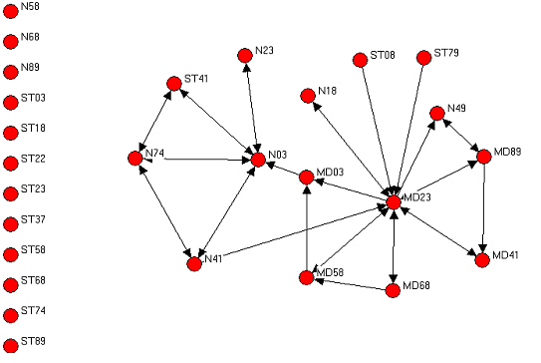
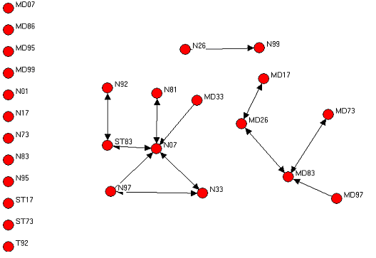
Informal Consulting Relationships in Clinics B and C
More isolates than in clinic A (A is specialized, smaller, and embedded in larger clinic)
Clinic B has a bridge between nurse and physician informal consulting groups

Slide 70
Informal Consulting - Summary
Informal consulting tends to occur within occupations
  But bridges can occur between occupations
  How might bridges be important?
Larger less specialized clinics have more isolates
  It could be that isolates consult outside of clinic
  How does presence of isolates affect clinic culture?

Slide 71
Informal Consulting and Work Groups
Temporary teams
  When groups consist of individuals from the same occupation, informal consulting occurs within work group (siloing)
Care teams
  When groups consist of individuals from different occupations, informal consulting occurs between work groups (spanning)

Slide 72
Informal Consulting: Managerial and Research Questions
Does informal consulting integrate occupations and teams within a clinic?
  Bridging relationships can be the basis of shared culture?
  How can bridging relationships be built?
Does having temporary teams without spanning informal consulting lead to greater siloing within occupations and greater distance between occupations in climate?
  Psychological safety? Safety culture?

Slide 73
Social Networks in Medical Clinics
Analyzed three relationships
  Work with
  Discuss care management processes
  Informal consulting
Significant differences
  Within clinics between relationships
  Within relationships between clinics
Performance is three relationships together
  How does putting the three together affect performance?

Slide 74
Social Networks and Clinics: Who Cares?
Research
Identify teams
Measure clinic structure
Test hypotheses
  Does having informal consulting relations that span care teams lead to better clinic integration?
  Does higher density in informal consulting result in greater homogeneity?
Management
Managers manage
  Processes, which are sets of routines
  People
  Relations
Social network tools allow patterns of relations to be observed and therefore managed
  Avoiding overly centralized care management structures

